Slide 1

The Second Document Intelligence Workshop
Doug Burdick, Dave Lewis, Yijuan Lu, Hamid Motahari, Sandeep Tata
Benjamin Han

Slide 2

What is Document Intelligence (DI)?
Understanding of real-life documents
Project reports, planning documents
Technical specifications
Financial statements
Meeting minutes
Legal agreements, contracts,
Purchase orders, invoices,
Resumes
…

Slide 3
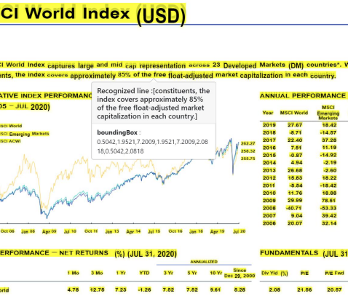
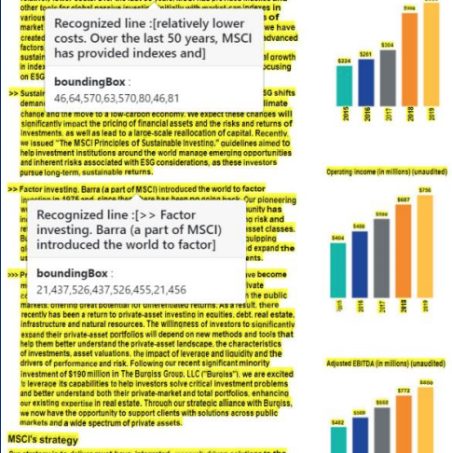
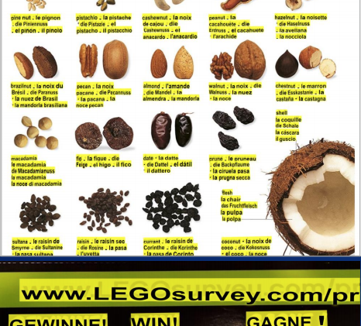
Why is DI Challenging?
Analog -> Digital (OCR)
Complex formats and structures
Domain-specific knowledge

Slide 4
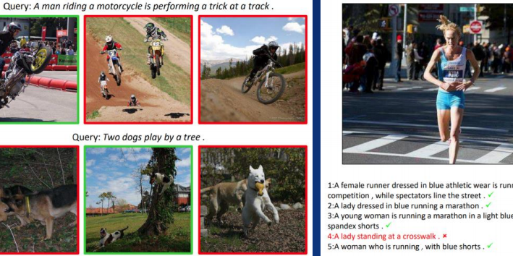
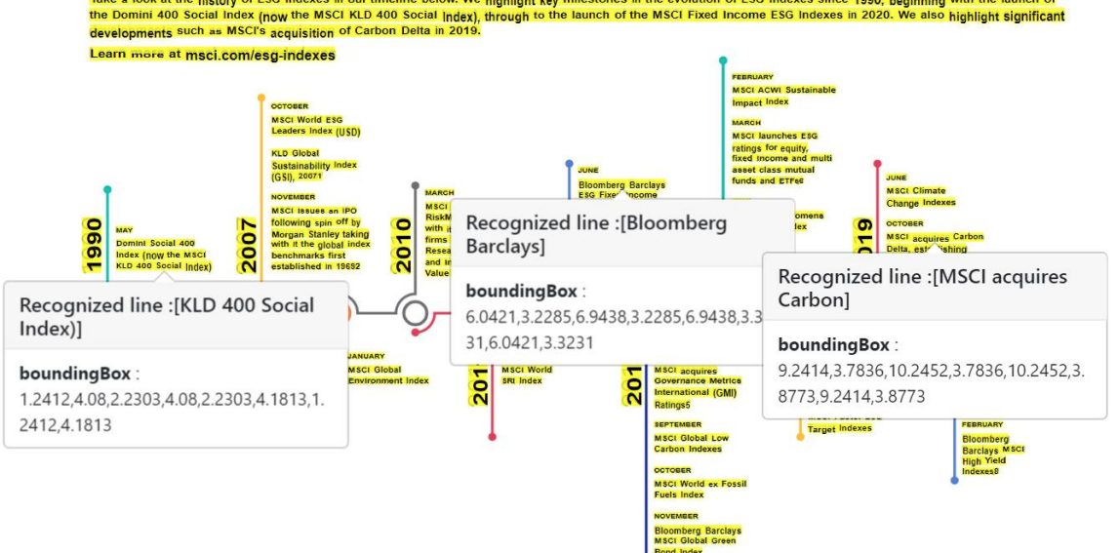
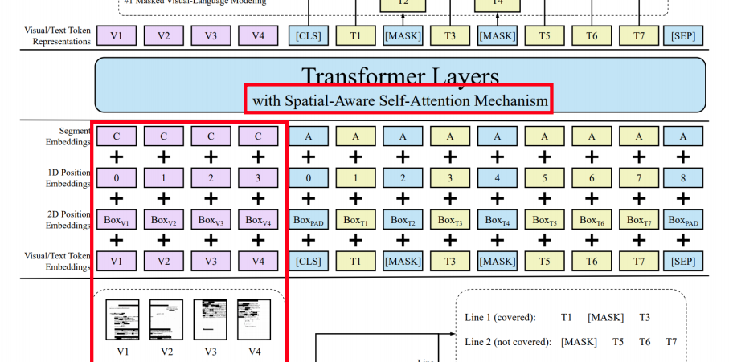
Natural Language Processing Deals with Disembodied Texts
DI requires multi-disciplinary perspectives
Natural language processing and understanding
Computer vision
Layout understanding
Knowledge representation and reasoning
Knowledge discovery
Data mining
Information retrieval
…
We need a venue for DI!

Slide 5
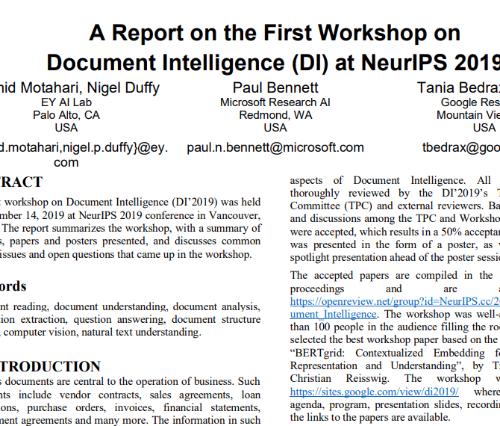
History of Document Intelligence Workshop
The 1st DI Workshop collocated with NeurIPS 2019, in Vancouver, BC, Canada
Organized by Nigel Duffy, Paul Bennett, Tania Bedrax Weiss, Rama Akkiraju and Hamid Motahari.
The workshop was a well-attended, filling the room to the 150 capacity with people standing.
The workshop received ~50 initial abstract submissions and 38 paper submissions. 19 papers were accepted resulting in a 50% acceptance rate.
The workshop also features 4 invited talks, a Best Paper presentation and a panel discussion.
The discussion was published in KDD Explorations (PDF).

Slide 6
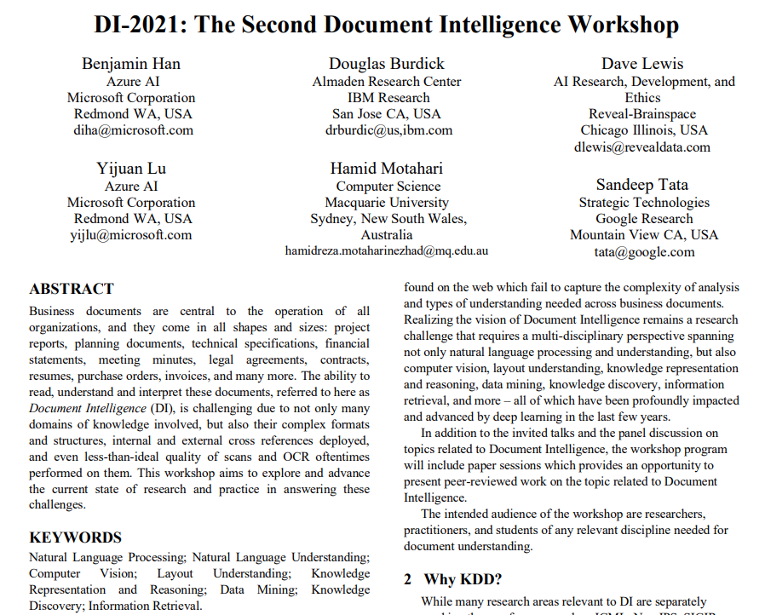
Document Intelligence @ KDD2021
DI-2021 Organized by Doug Burdick, Dave Lewis, Yijuan Lu, Hamid Motahari, Sandeep Tata, and Benjamin Han (chair).
Received 21 paper submissions
Accepted 10 papers and 5 posters. Paper acceptance rate = 47.6%
Three broad themes
Session 1 – OCR & Visual Document Intelligence: 4 papers and 1 poster
Session 2 – Machine Learning: 4 papers and 1 poster
Session 3 – Applications: 2 papers and 3 posters
DI-2021 also features 6 invited talks, a Best Paper presentation and a panel discussion.

Slide 7
Thank You Reviewers!
# | Full Name | Affiliation
1 | Charles Beller | IBM
2 | Tongfei Chen | Microsoft
3 | Freddy Chua | Ernst & Young
4 | John Corring | Microsoft
5 | Daniel Campos | University of Illinois at Urbana-Champaign
6 | Marina Danilevsky | IBM
7 | Jonathan Degange | Ernst & Young
8 | Yasuhisa Fujii | Google
9 | Revanth Gangi Reddy | University of Illinois at Urbana-Champaign
10 | Sean Goldberg | Microsoft
11 | Beliz Gunel | Stanford University
12 | Ruining He | Google
13 | Bruce Hedin | H5
14 | Hans Henseler | University of Applied Sciences Leiden
15 | Mehrdad Jabbarzadeh Gangeh | Ernst & Young
16 | Antonio Jose Jimeno Yepes | University of Melbourne
17 | Amanda Jones | H5
18 | Priyanka Kulkarni | Microsoft
19 | Sameer Kulkarni | Google
20 | Chen-Yu Lee | Google
21 | Manling Li | University of Illinois at Urbana-Champaign
22 | James Mayfield | Johns Hopkins University
23 | Graham McDonald | University of Glasgow
24 | Lesly Miculicich | Microsoft
25 | Mark Noel | Hogan Lovells
26 | Feifei Pan | Rensselaer Polytechnic Institute
27 | Navneet Potti | Google
28 | Xiaoqi Ren | Google
29 | Herbert Roitblat | Mimecast
30 | Amr Sharaf | Microsoft
31 | Ying Sheng | Google
32 | Baoguang Shi | Microsoft
33 | Peter Staar | IBM
34 | Baochen Sun | Microsoft
35 | Dan Tecuci | Ernst & Young
36 | Jyothi Vinjumur | Walmart
37 | Guoxin Wang | Microsoft
38 | Sen Wu | Stanford University
39 | Yuan Xie | Microsoft
40 | Li Yang | Google
41 | Qi Zeng | University of Illinois at Urbana-Champaign

Slide 8
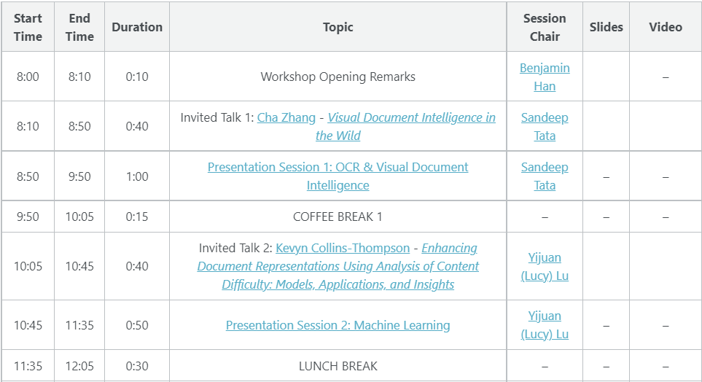
DI-2021 Program: Morning

Slide 9
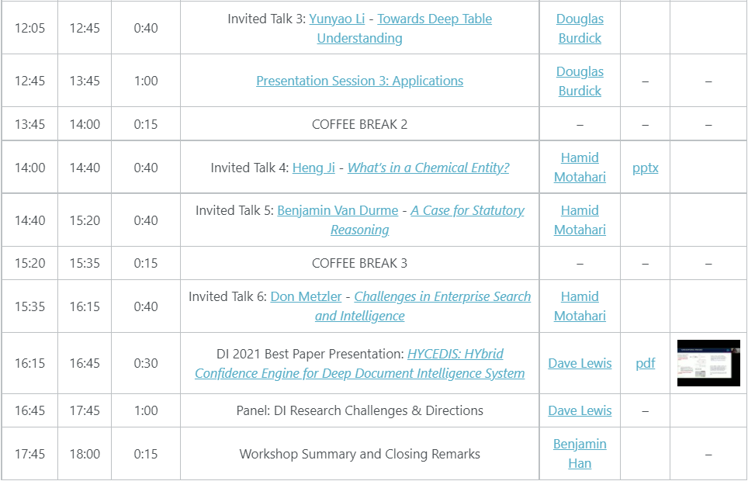
DI-2021 Program: Afternoon

Slide 10
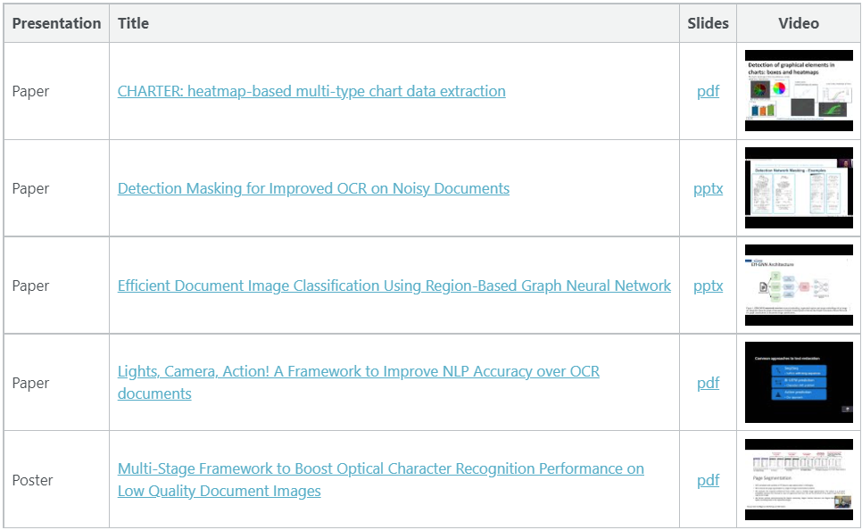
Presentation Session 1: OCR & Visual Document Intelligence

Slide 11
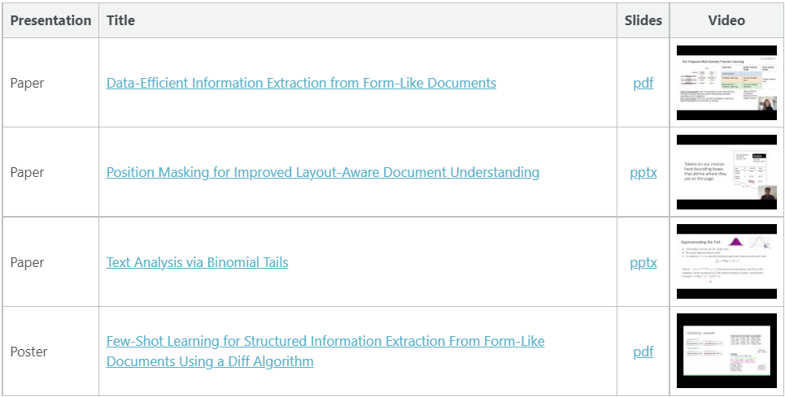
Presentation Session 2: Machine Learning

Slide 12
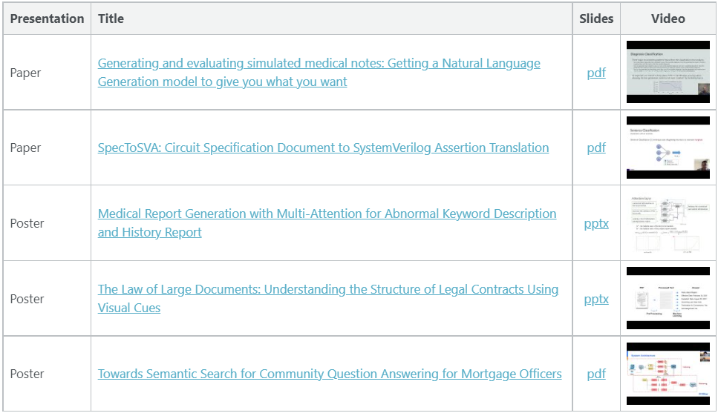
Presentation Session 3: Applications

Slide 13
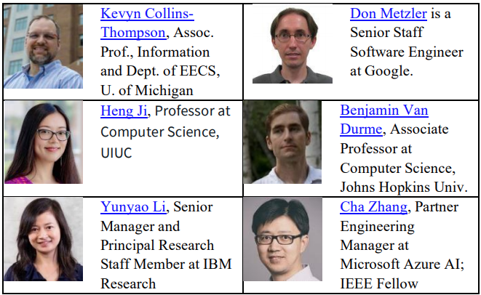
Invited Talks and Panel Discussions
Invited Speakers are Panelists.
All 6 talks and Panel Discussions will be recorded and made available.

Slide 14
Thank You!

